Slide 1
Wholesome and Healthy at the Farmers’ Market
Dr. Kristen Gibson
Assistant Professor, Food Science
University of Arkansas
Food Distribution Research Society 2016 Conference

Slide 2
Farmers’ Market Food Safety Project: 10/2013 to 9/2017
Source: http://www.miromaroutlets.com/

Slide 3
What about food safety at farmers’ markets?

Slide 4
Why is this important to FDRS participants?

Slide 5
What we proposed to do…
Objective 3:
Configure the most sanitary market
Objective 1: Focus groups with FM managers/vendors
Objective 4: National resource of food safety jurisdiction
Objective 2: Focus groups with FM customers
Objective 5: Interactive food safety apps for smartphones and web-users

Slide 6
What did we learn?
People are “app’ed” OUT
September 20, 2016
Notes:
Sampling Strategy
USDA local food directory
# of farmers’ market per region
Inclusion criteria: website, accept SNAP and WIC
Random number generator for FM selection by region
10 per region = 100 total

Slide 7
What did we learn?
People are “app’ed” OUT
Based on web content analysis, FM managers don’t provide food safety info to customers
4 out of 100 post on website
1 out of 100 have actual FM customer guide
Notes:
Sampling Strategy
USDA local food directory
# of farmers’ market per region
Inclusion criteria: website, accept SNAP and WIC
Random number generator for FM selection by region
10 per region = 100 total

Slide 8
How can we reach each farmers’ market stakeholder?
Provide tools and resources for market managers to engage vendors and consumers
Encourage vendors/producers to provide food safety education for their customers
Food Safety Events
Newsletters/Fact Sheets
Social Media
Notes:
Encourage market manager and vendors/producers to educate their consumers
Teach consumers how to transport, store, and prepare their products safely
Include information for each to prepare nutritious recipes to encourage loyal consumers
Post proper hand washing information in restrooms
Support special events that demonstrate safe food handling practices
Encourage vendors/producers to be properly trained
Develop response plan
Market managers and CSAs can include food safety tips and information in newsletters
Social media: Facebook, Twitter, Instagram
Newsletters and fact sheets
Inform and remind customers about food safety risks and safe handling practices
Demonstrations and Food Safety Events
Proper procedures can be demonstrated
Equipment can be displayed
Customers can be given opportunity to ask questions and pick up fact sheets or other information on food safety

Slide 10
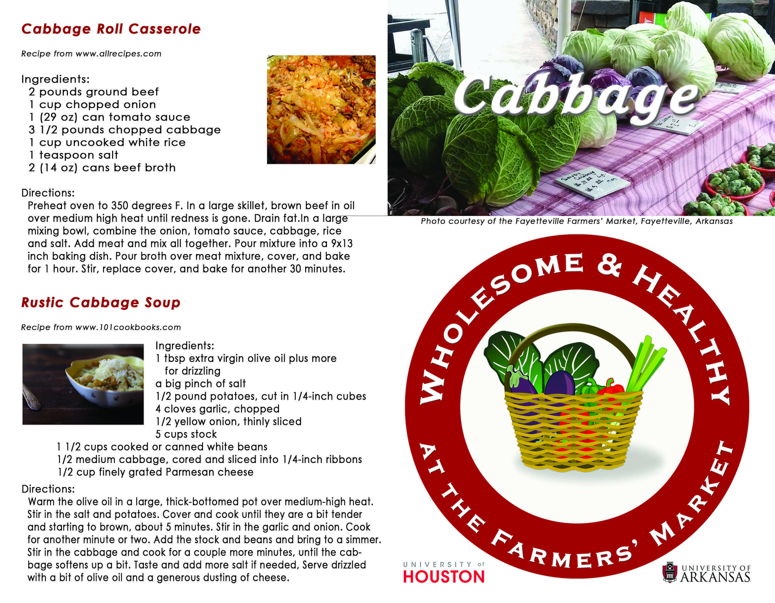

Slide 11
WHFM kit: Input and Beta Test
Farmers’ market manager meeting
Mini “focus group” to get input on WHFM materials
12 people representing 9 markets
Beta Test
Northwest Arkansas
5 markets
8 – 43 produce vendors
300 to 7,000 customers
Notes:
FM Meeting Suggestions:
providing materials in Spanish
putting a coupon on the back of the wash me card to encourage consumers to come back, and so the cards can be reused
adding the “know your farmer” concept and distinguishing between produce that is “not safe” vs. “not pretty”
finding a way to address consumers and children touching the produce and pets in the market
use humor
photo novella
changing the “throw out” icon to “compost”
using dropbox space for the kit (I had difficulty getting all the elements uploaded to our website)
changing “clean with bleach” to “sanitize” in the brochure
including other items besides produce (meat, eggs, dairy)

Slide 12
Beta Test: Summary
Used follow up Dot Survey
107 survey responses across 5 markets
69% noticed the WHFM materials
Food safety awareness?
72% that noticed WHFM materials felt the learned something about food safety
Feedback
Traditional or electronic survey preferred
Translate materials to Spanish

Slide 13
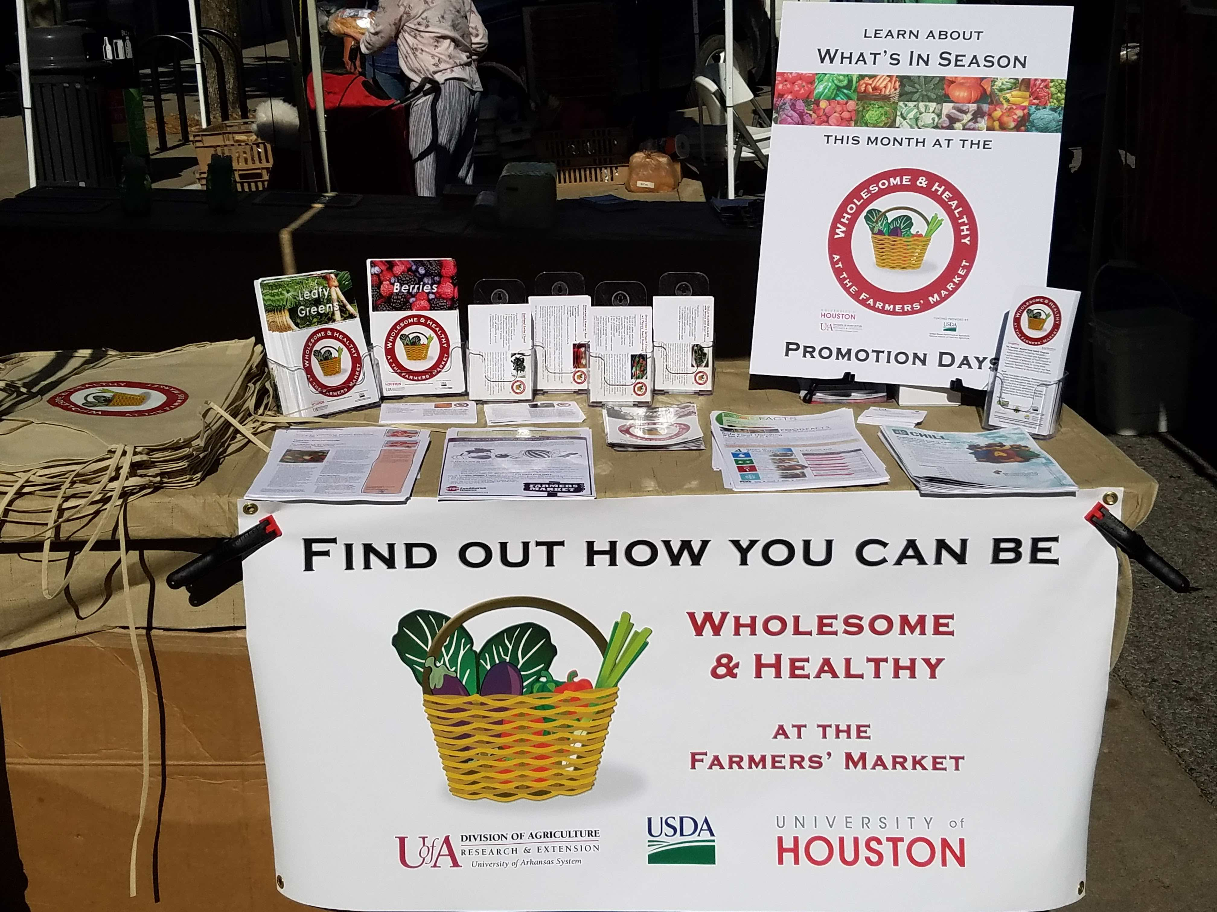
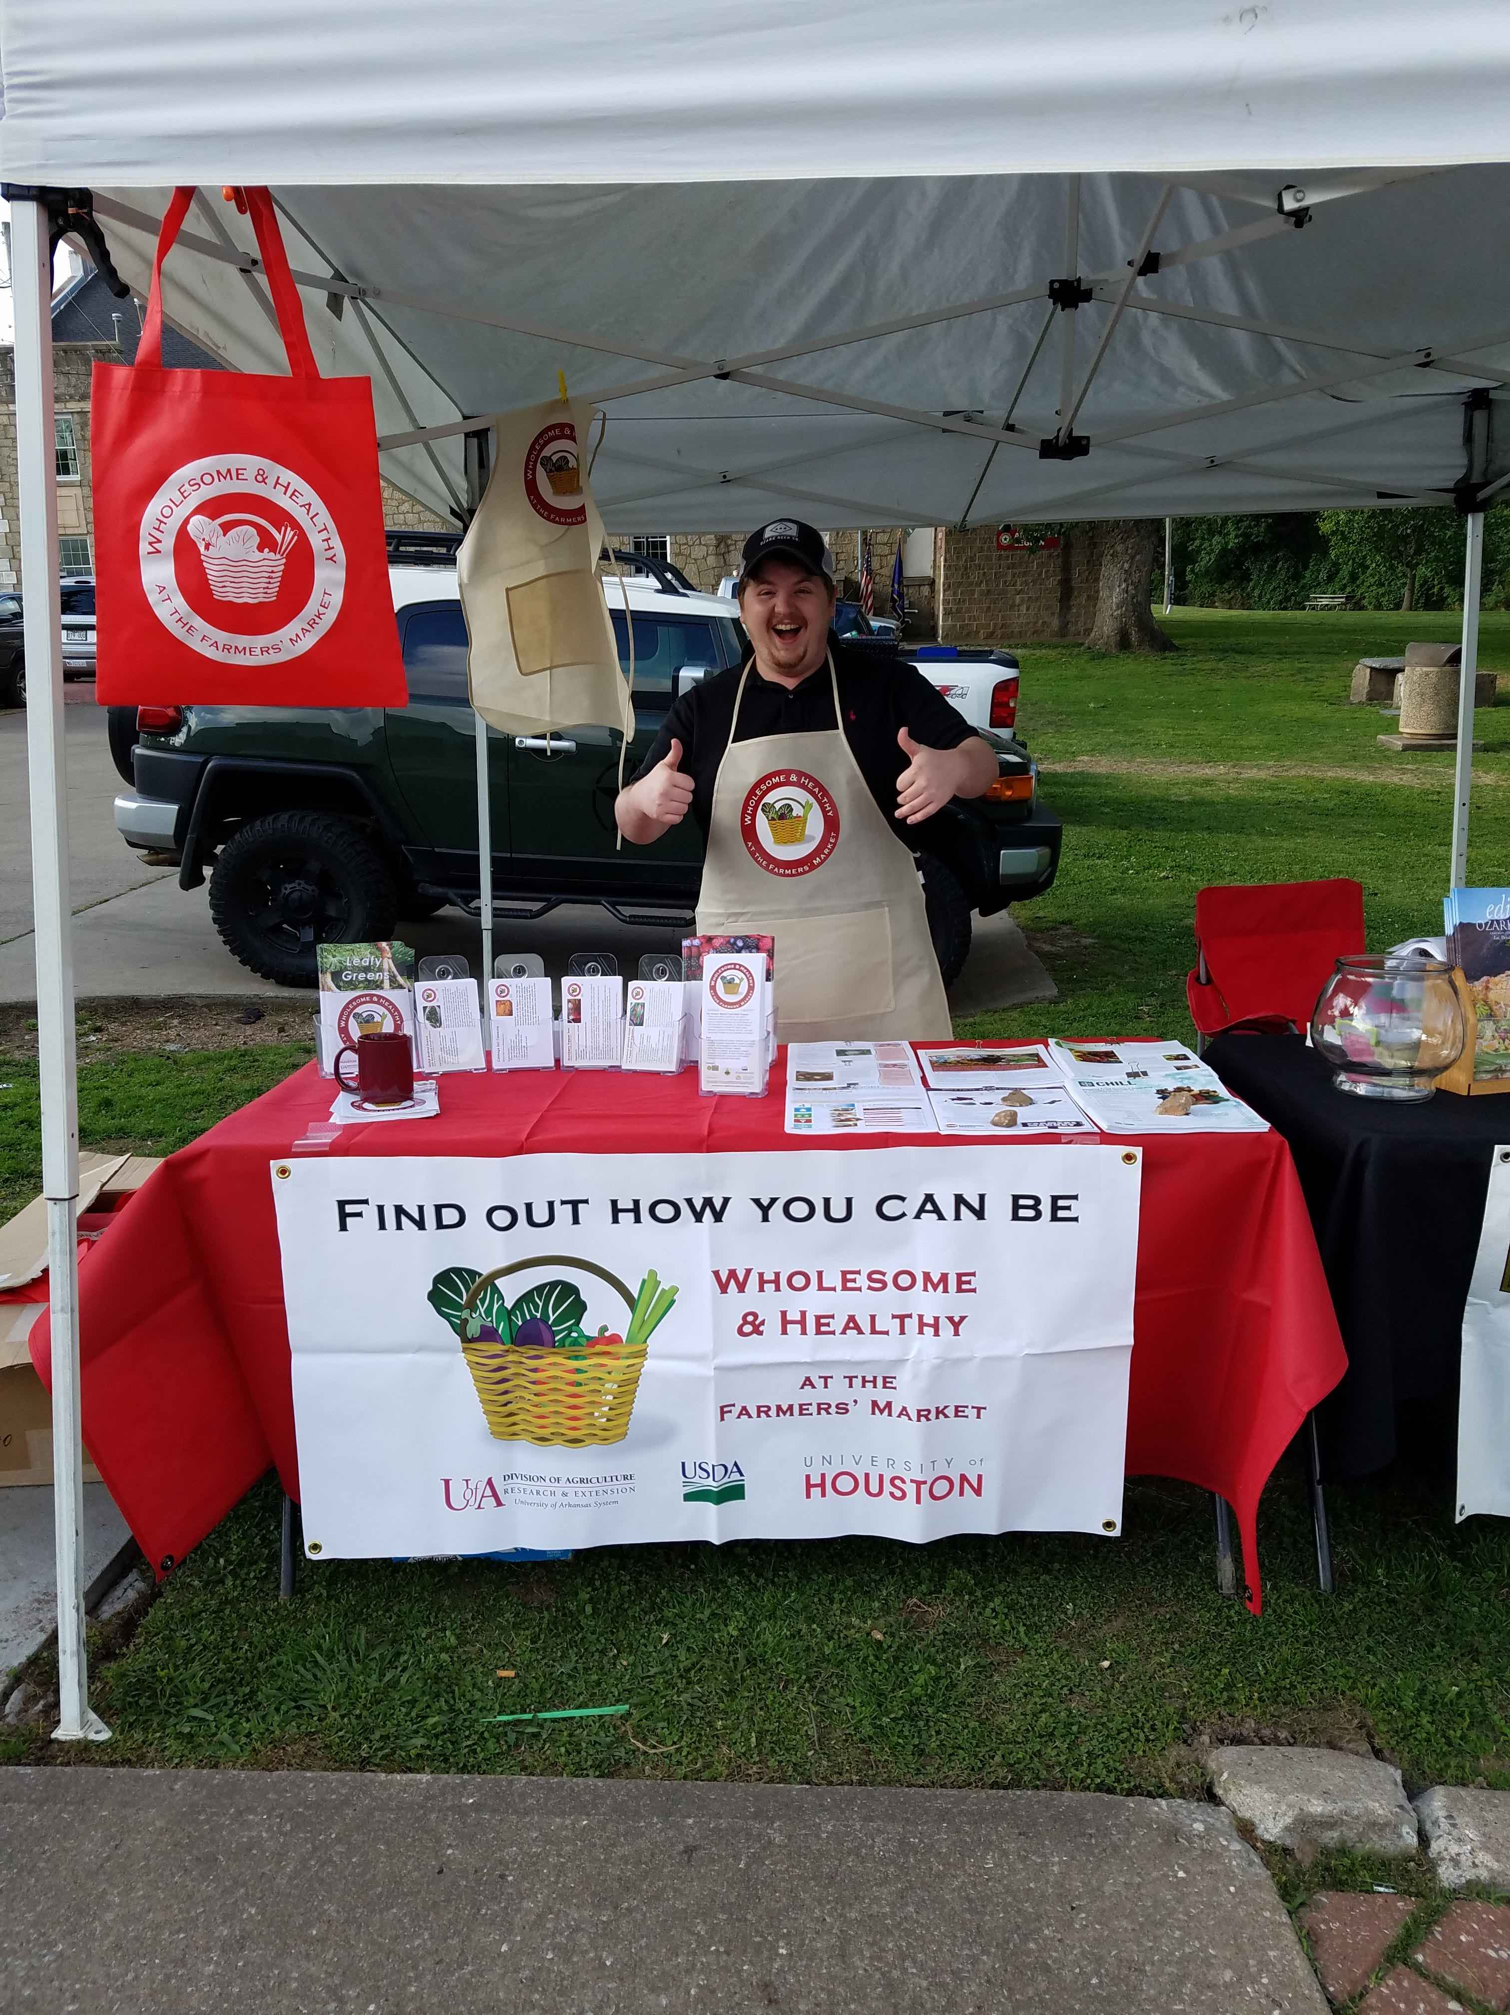

Slide 14
“I felt the customers enjoyed receiving the bags and many of them took recipe cards and food safety sheets. The farmers LOVED the ‘Wash Me’ cards. They were so happy to have them and to see we wanted to educate consumers about their role and responsibility in food safety…[]… Love the program and really want to utilize it more. Thanks!”
- Stacy Hester, Siloam Springs Market Manager

Slide 15
What’s next for farmers’ market food safety?
USDA-NIFA Food Safety Outreach Program
Virginia, Georgia, North Caroline, Texas
Farm-to-Table Food Safety kit for local food stakeholders
10/2016 to 9/2018

Slide 16
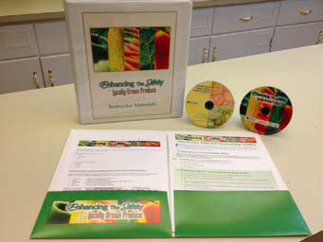
Combining, optimizing, and validating materials that have been developed
Make available through eXtension, state extension, and Farmers Market Coalition
Creation of Farmers’ Market Food Safety Plan templates
Expansion to other local food venues and markets…

Slide 17
Acknowledgements
University of Arkansas Team
Katie Wright
Matthew Dean
University of Houston Team
Jay Neal
Sujata Sirsat
Kristen Kirkwood, Hillary Norwood, Mary Goodman, Lydia Liou, Chandler Yu

Slide 18
Questions?
Contact:
Kristen Gibson
keg005@uark.edu
479-575-6844

